Slide 1
Math in music

Slide 2
Introduction
The Ancient Greek philosopher once said that „World is ruled by numbers”. There seems to be some truth in this words cause wherever w look we can see that now Pitagoras’s words are truer than truth. Each of us carry a small hand-sized computer with computing power, for which half a century ago all universities and governments of this world would give any price. Architects, engineers, designers all use calculations to present the world with ever safer and more and more innovative solutions. Using mathematical formulas, artists can create amazing works, even in music we can find examples of the use of formulas and calculations. Despite what they teach us in maths lessons, the greatest discovery of Pythagoras was not, the theorem on rectangular triangles, but the mathematization of music. The discovery of Pythagoras was used, even by Ludwig van Beethoven.

Slide 3
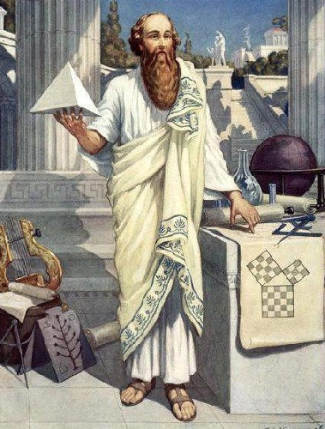
Legend about Pitagoras
According to one of the legends, When Pythagoras was passing the streets of the island of Samos. During his walk, he heard a sound of striking the hammer's anvil coming from the nearby forge. Pythagoras ran to the workshop and, inspired, began to analyze mathematically the shape of a blacksmith's hammer in search of the harmony of the sound heard, thus contributing to the foundations of today's music. Later in that story, Pythagoras decided to investigate the sound of concrete hammers. He discovered that 2 hammers of the same size seem harmonious to one heavier hammer. After weighing it turned out that the weight of the larger hammer corresponds to the weight of 2 smaller hammers. To understand this relationship Pythagoras turned his attention to one of the simplest string instruments.

Slide 4
Waves and sounds
As we all know, sound is a wave and the frequency is the main factor that defines individual notes. But what is the frequency you can ask. Frequency is in other words repeatability. Imagine a pendulum that performs one full swing for a second. We say then that the frequency of this pendulum is 1 Hz (one full cycle per second). If we increase the frequency of this pendulum to, for example, 20Hz, it will perform 20 full swing in 1 second. When we know what frequency is, we can now determine its connection to music. Each note corresponds to a different frequency for example, the frequency of note A is 440 Hz
Notes:
Today such dependence is called the octave. Two notes with the same symbol are separated by an octave from each other. In a big simplification, this means that if 2 notes are played on 2 strings, one of which is twice as long, after entering them into vibrations they will play sounds distant from each other by an octave. However, the question remains, why sounds distant from each other by an octave form a harmony. This can be explained by the example of the low C string. If we catch such a half string (we will reduce the frequency of vibrations by half, it will play the same sound, but by an octave lower.

Slide 5
Pitagoras’s discovery
Pythagoras discovered this dependence by studying strings of different lengths. He also found that if he took the string by 1/3 of the length of the longest of strings it would produce a whole new sound. Despite the fact that the sound was different, it created a pleasing sound with a sound from the strings of ½ initial length. Thanks to this discovery he was able to construct an instrument that was able to play sounds that seem to be continually increasing for our brain. However, if music was created only from octaves, it would be simply boring. That's why we have to take a step forward to create new notes. We will do it based only on the principles of harmony. Let's assume that our sample page plays the base note "0". There are also notes different from the "0" note with an octave that will also be called the "0" note. But music does not consist of only one note. To create more we can, for example, divide the page into three parts. Then a note 1 is created which is contained in note 0. Then we say that note 1 is the so-called fifth pure note 0. By dividing subsequent notes into 3 and increasing them or reducing by an octave we get a set of completely new notes. We should have a finite number of notes, however, in order to obtain such an effect, the note n created by us would have to be the same as note 0. To be exact it would have to be an octave higher than note 0. However, it is not difficult to refute this statement because there must be perfect harmony we must have infinite the number of notes is called the claim about the impossibility of music. This is because each note we create is obtained by dividing the note n into 3. The note n corresponds to 1 / 3n of the original string.

Slide 6
Civilizations and music systems
Many civilizations have created their own music system, for example China based on the Pythagorean idea used a stringed system. They played note C and then divided the string into 3 parts and received the note G. They noticed that between these notes there is harmony and began to divide the next notes to 3. When they came to notes B there was a problem. There was disharmony between note B and note C. For this reason, the Chinese finished their work on the notes C, G, D, A, E, pushing B aside. These notes served as the basis for Chinese music. Western music has 12 notes in it including B notes. Westerners have noticed that notes C and B are close to each other. In the western system, all the notes are the same distance from each other. And this distance is the distance between note C and note B.

Slide 7
Thank you for your attention

