Slide 1
Erasmus project
Use of math in the real life

Slide 2
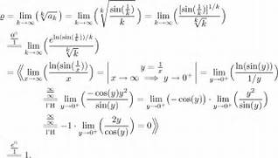
Use of primary/secondary/university math in the real life
Easy math problem
Probably use in real lifer
Hard math problem
Probably no use in real life

Slide 3
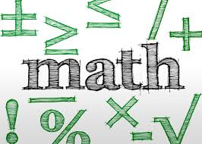
How math can help u in real life
Math can help count ton of sg
In science math make the scientists job easier
In teachers case one more type of turtue

Slide 4
Thanks for watching!

