Slide 1
Cardiovascular diseases
Authors: Przemysław Dybcio, Jakub Wituch, Celina Kopeć
Translator: Iga podkościelna

Slide 2
Diseases of circulatory system id est cardiovascular diseases are the most common cause of death in Poland. Such diseases occur due to the so called risk factors. People in whom several such factors occur at the same time are especially threatened with developing cardivascular diseases.

Slide 3
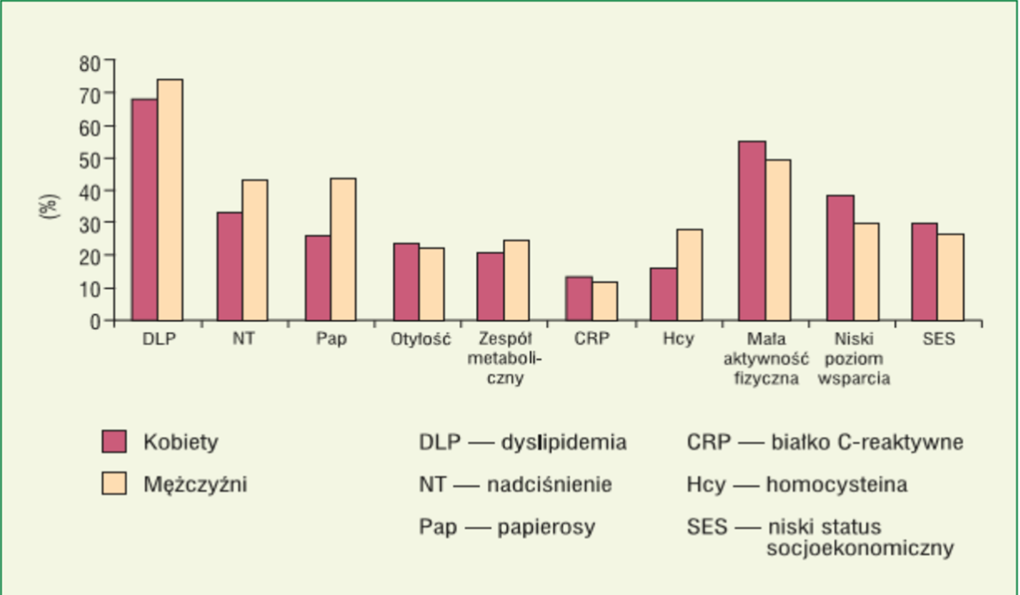
Risk factors for cardiovascular diseases

Slide 4
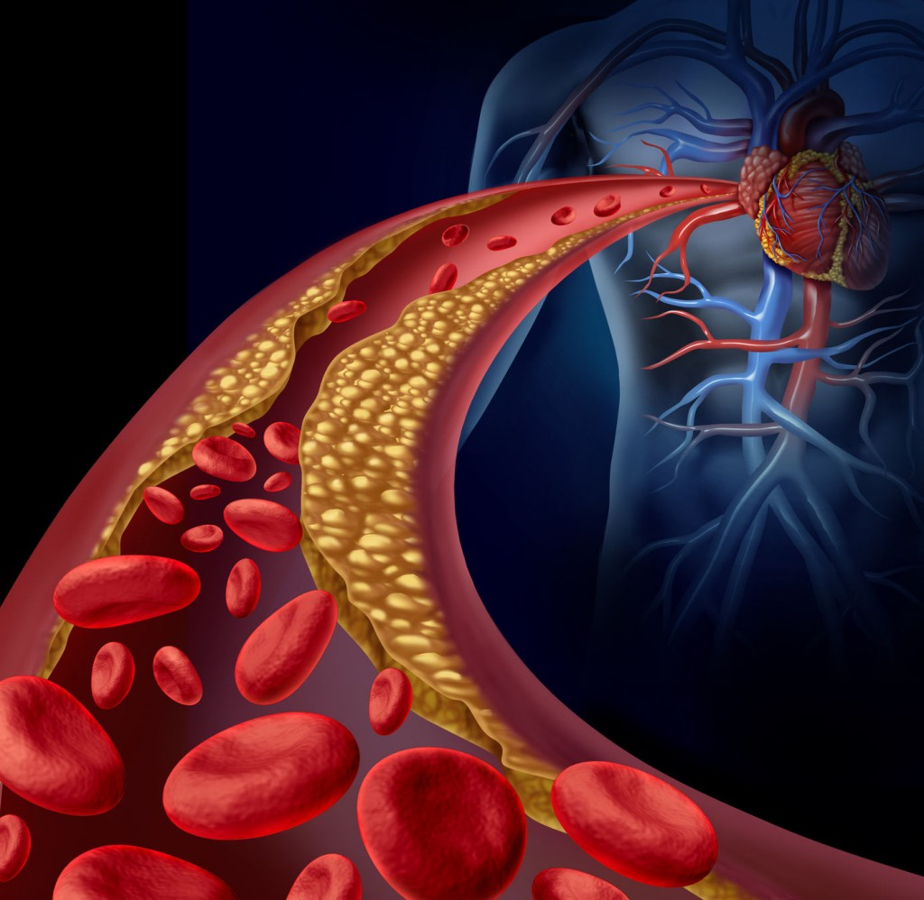
Dyslipidemia is a condition wherein the amount of lipids in blood plasma is incorrect.
There are four types of lipoproteins: HDL (called good cholesterol), VLDL, chylomicrons and LDL (called bad cholesterol).

Slide 5
Arterial hypertension (Hypertensio arterialis) is a disease of circulatory system reliant on constant or periodic elevated blood pressure above the correct values that is 140/90 mmHg.

Slide 6
Cigarette smoking in Europe is the reason for every fourth death caused by cardiovascular disease.

Slide 7
Even teenagers, who begin to suffer from overweight or have too high blood pressure are threatened with atherosclerosis of internal walls of the artery, which make them lose their normal flexibility.

Slide 8
Metabolic Syndrom is a serious condition, which not so long ago affected only an adult section of our population. It is a set of factors which increase the risk of cardiovascular diseases.

Slide 9
CRP is a C-Reactive Protein - an acute phase protein, appearing in the blood as a consequence of inflammation.

Slide 10
Homocysteine is type of amino acid present in the human body. Homocysteine occurs in our blood as a result of digesting foods containing protein. Small amount of homocysteine is necessary for the proper functioning of the body.

Slide 11
Human is a creature, who needs a certain dose of pysical activity to function proerly. The amount of physical effort performed by people in everyday life has drastically decreased. Low level of physical activity or total lack of it, the so-called hypokinesia induce in the human body negative changes.

Slide 12
