Slide 1
Maths and Music
Maths Matter – Poland 2019

Slide 2
Maths and Music

Slide 3
Definition:
A harmony of different notes/frequencies
Music
Maths and Music

Slide 4
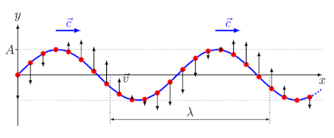
Waves
Definition:
a spatially propagating periodic or one-time change in the state of equilibrium
Music
Maths and Music

Slide 5
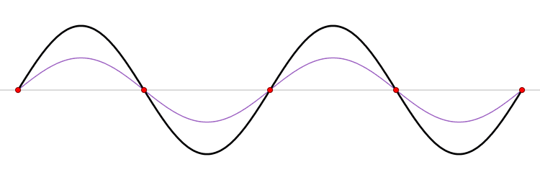
Waves
Stationary waves
Music
Definition:
Resulting wave of two counter-rotating waves with fixed zeros
Maths and Music

Slide 6
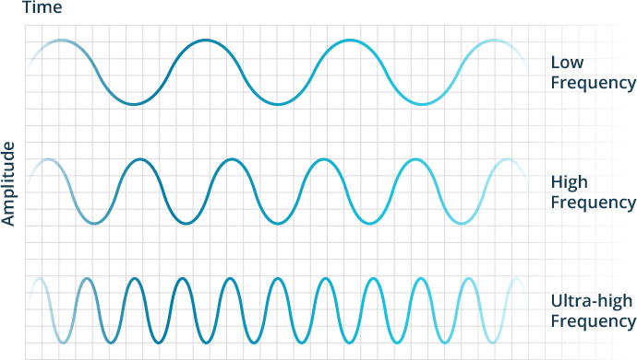
Waves
Definition:
Measured for the speed of how fast a periodic process repeats itself
Stationary waves
Music
Maths and Music
Frequencies

Slide 7
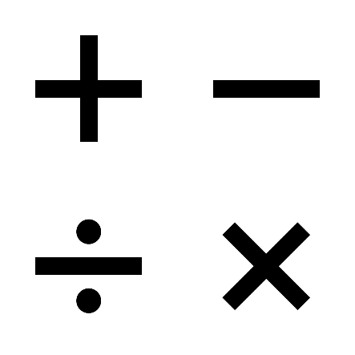
Waves
Multiples and fractions for a harmony of different frequencies
Otherwise → Termination of the waves
Stationary waves
Music
Maths and Music
Frequencies
Multiples and fractions

Slide 8
Waves
Definition:
Indicates the desired tone; Speed, duration and altitude
Stationary waves
Music
Maths and Music
Frequencies
Music notes
Multiples and fractions

