Slide 1
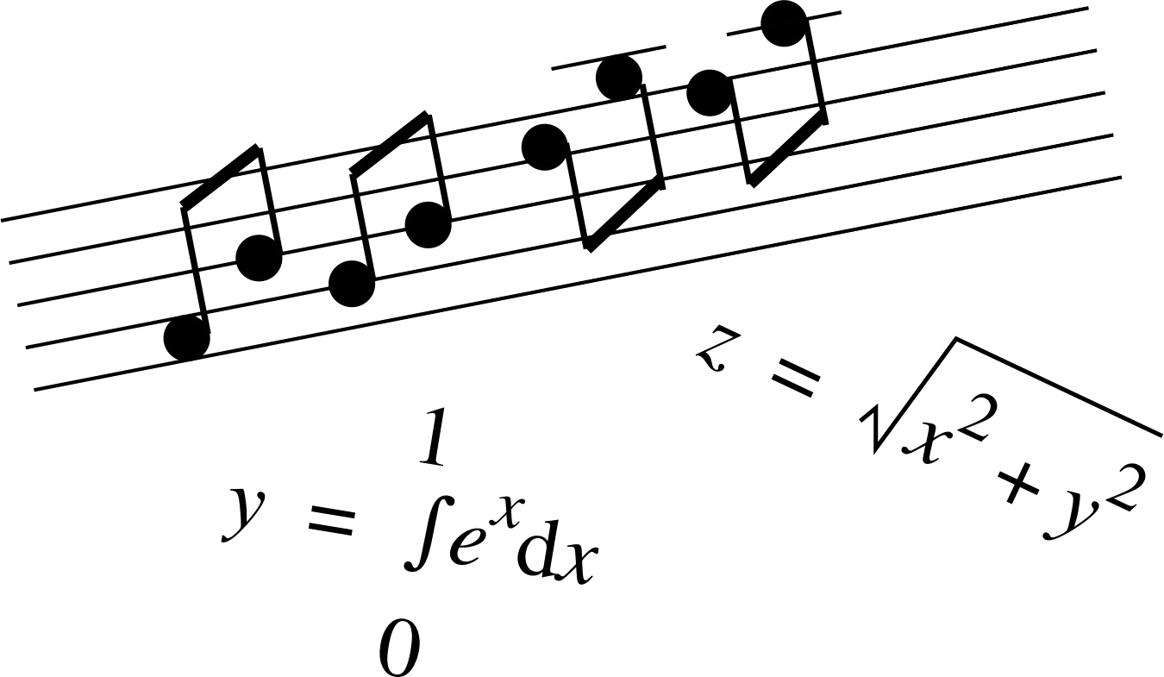
MUSIC AND MATHEMATICS

Slide 2
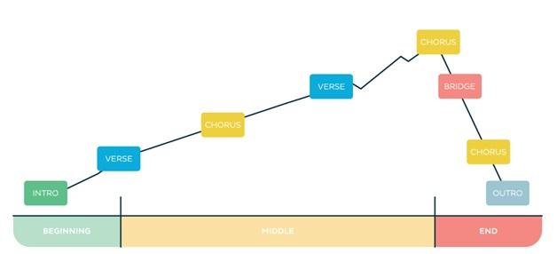
Mathematics in Music
There are patterns in every music
Patterns can be repeated designs or recurring sequence
Notes placed into groups
These groups makes the melodical structure

Slide 3
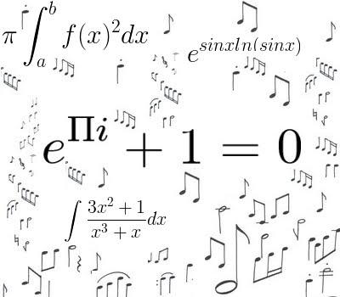
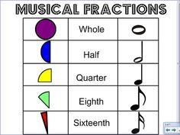
You have to use Maths
Musics have mathemaitcal patterns , these are simetries
You have to know, that the patterns how interract with each other
You also need to deal with the speed and rhythm of musical instruments

Slide 4
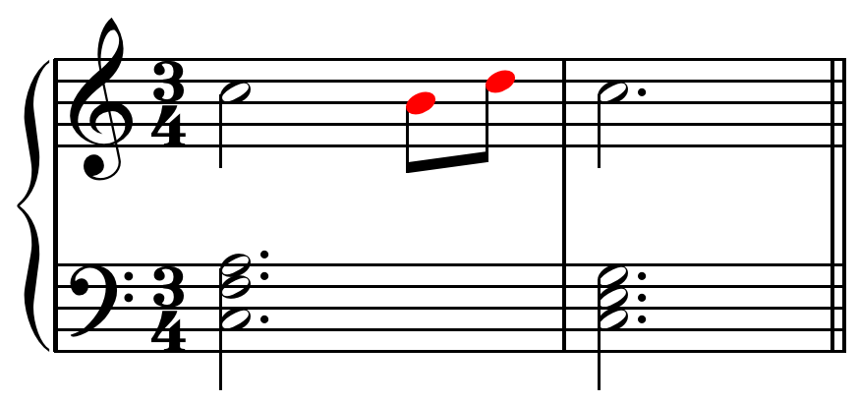
The connection between Music and Maths
Scales
Intervals
Frequencies
Tones

Slide 5
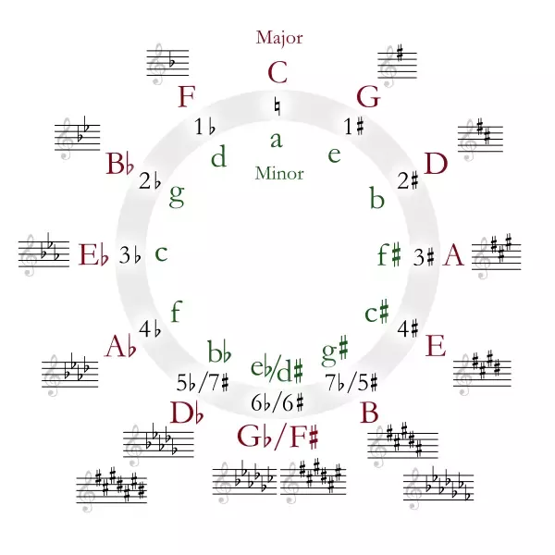
How closely related are Music and Maths ?
This relationship is thousands of years old
You can study in Music: - different mathematical perspectives - geometry - number theory - combinatorics
You have to understand maths if you want to know how modern music works
The circle of fifhts

Slide 6
THANK YOU FOR YOUR ATTENTION
“There is geometry in the humming of the strings, there is music in the spacing of the spheres.” (Pythagoras)

