Slide 1
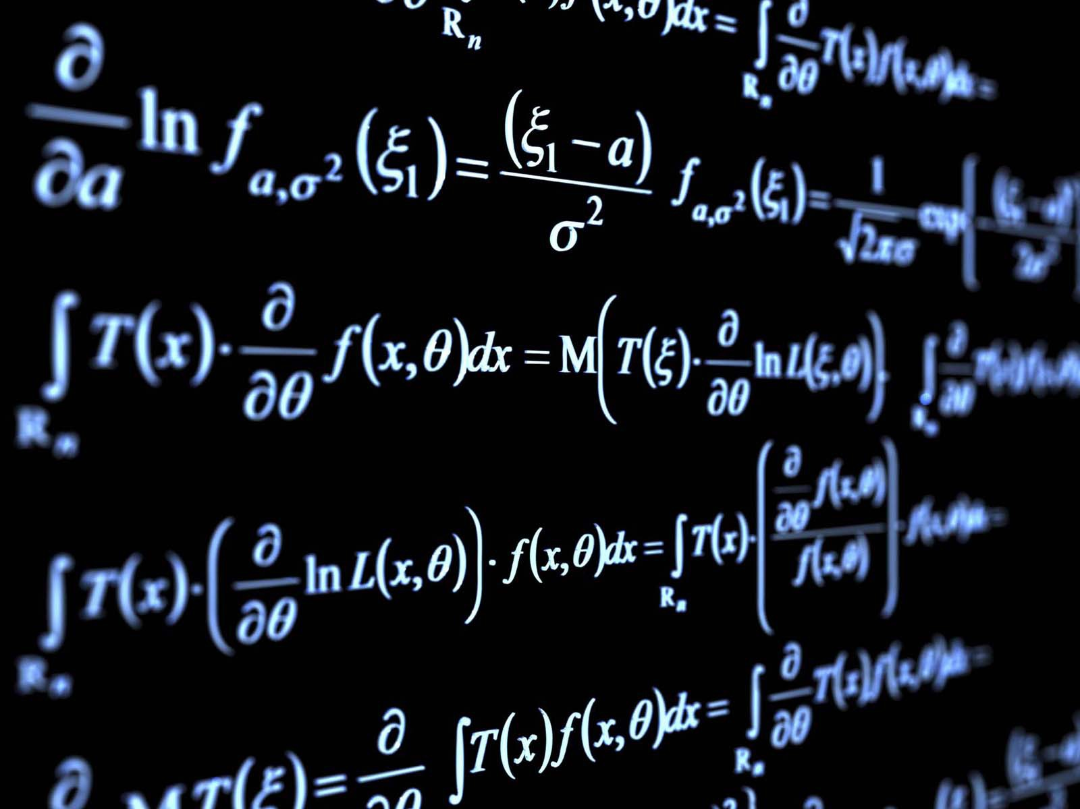
Mathematics and Music
Is there any connection between the two of them?

Slide 2
What is the relationship between music and math?
Well composed music is structured and organized.
Math also can help as a language to describe things more orderly and more structured.
Mathematics can be described as the study of patterns. Music involves creating patterns of sounds.
Composing
Spontaneity : Speculation -> Inspiration, Motivation, Vision -When composing Math gives us a basis.
Notes:
Math is a general language which helps within every ordered and structural built-in can be written down by mathematical language.
The good music was always an organized and arranged thing and that order can be expressed by the language of math.

Slide 3
Description
Rhythm - toe tapping → periodic function Melody - musical note made up of waves -> produced by vibration of a string - particular, pleasurable notes when played in a sequence as a melody often have particular mathematical relationships. Interval - ‘distance’ between two musical notes - ratio of the frequency - popular interval perfect fifth -> interval between C and G (‘do’ and ‘so’) - the ratio between 2 frequencies is 2:3 Harmony - playing multiple notes at the same time - chords that sound harmonious to most ears contain the same integer intervals that are often considered melodious.

Slide 4
Thank you for your attention!
Made by: Gergely Bárkányi

