Slide 1
The Correlation between Maths and Music

Slide 2
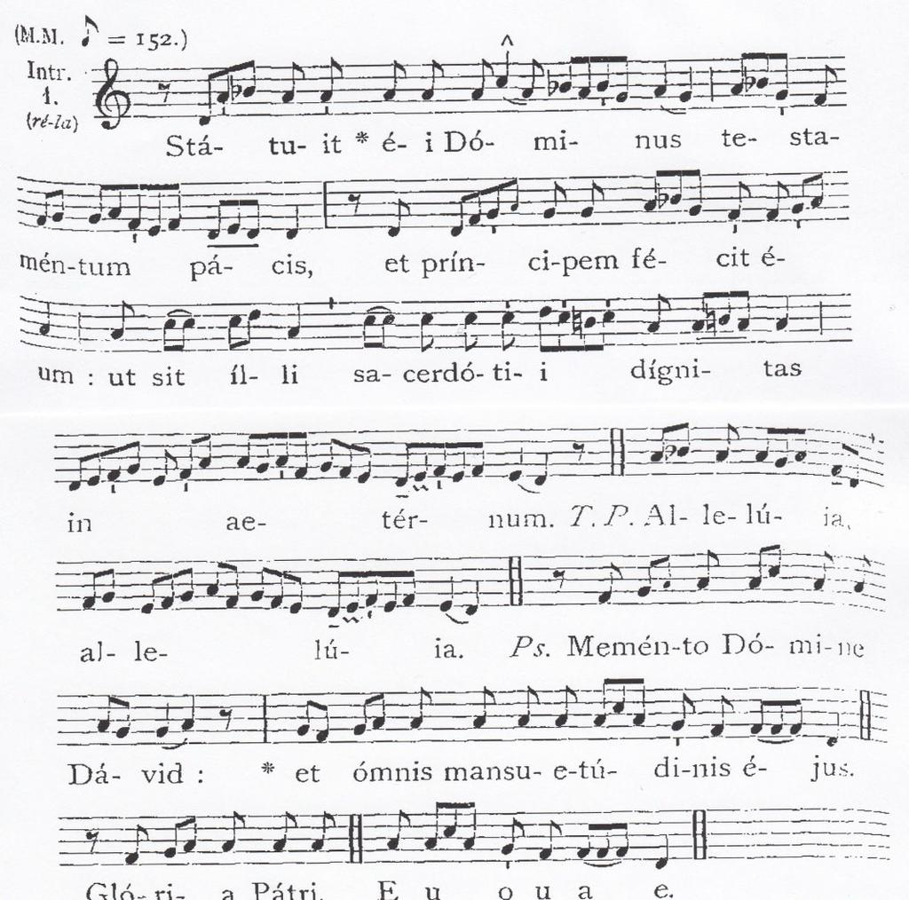
Pythagoras once said, “there is geometry in the humming of the strings, there is music in the spacing of the spheres.” He was right. Music is entirely intertwined with mathematics, because even a basic major chord can be described mathematically.
Elements of music such as its form, rhythm and metre, the pitches of notes and the tempo can be related to the measurement of time and frequency.
Mathematics can be traced in common musical concepts, such as wave frequencies, scales, intervals and tones.

Slide 3
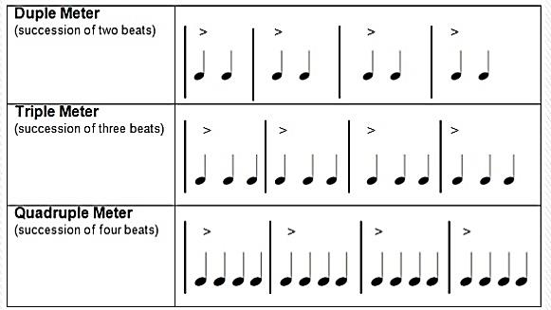
Rhythm and metre
Music wouldn’t be possible without the boundaries of rhythmic structure which is a fundamental equal and regular arrangement of pulse repetition, accent, phrase and duration.
The elements of musical form often build strict proportions or hypermetric structures (powers of the numbers 2 and 3).

Slide 4
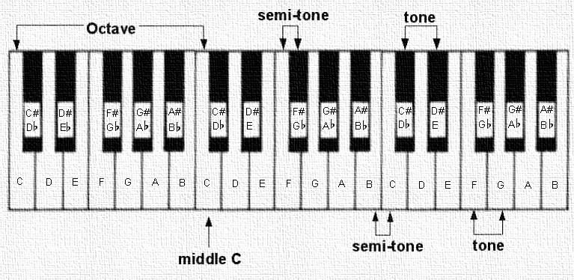
Intervals & Tones
Each note has a unique frequency, yet when combined, not all of these frequencies will make a beautiful harmonic chord.
Intervals that make a beautiful sounding chord have sound waves that reverberate in similar patterns. For example a middle A major interval is made of A (440 Hz) and E (659.25 Hz). With A on the bottom and E on the top, it will become clear that the frequency of E is approximately 3/2 larger than that of A, making an easy, digestible fraction. This simple mathematical relationship is largely why the two notes sound so pleasing together.

Slide 5
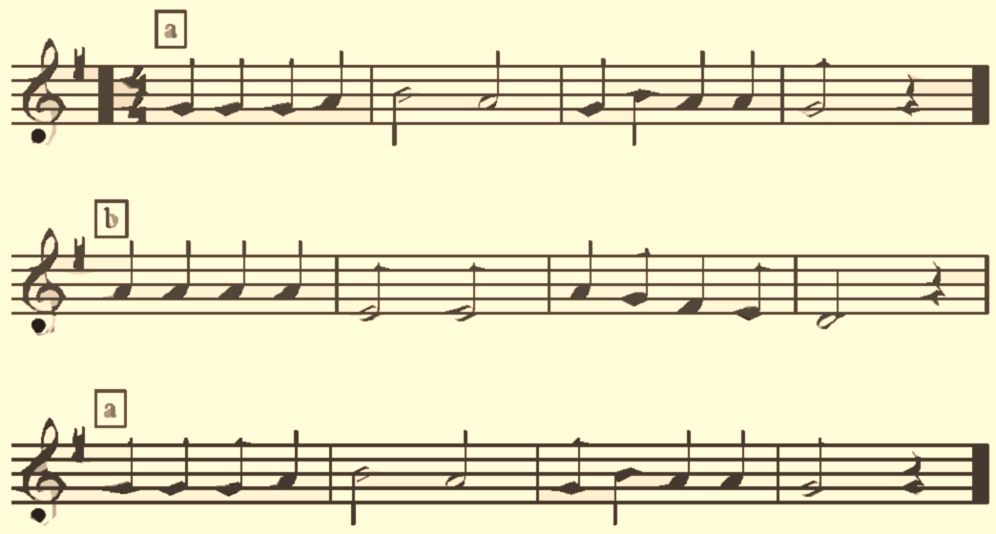
Musical Form
Musical form is the plan by which a short piece of music is extended. The term "plan" is also used in architecture, to which musical form is often compared. Like the architect, the composer must take into account the function for which the work is intended and the means available, practicing economy and making use of repetition and order.
The common types of form known as binary (“twofold”) and ternary (“threefold”) demonstrate the importance of small integral values to the intelligibility and appeal of music.

Slide 6
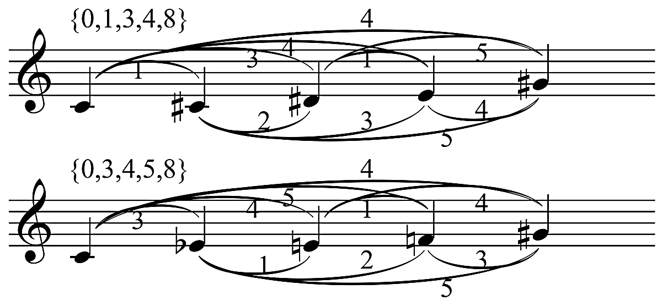
Set theory
Musical set theory uses the language of mathematical set theory in an elementary way to organize musical objects and describe their relationships.
To analyse the structure of a piece of music using musical set theory, you usually start with a set of tones, which could form motives or chords.
By applying simple operations such as transposition and inversion, you can discover deep structures in the music.
Such operations are called isometrics because they preserve the intervals between tones in a set.

Slide 7
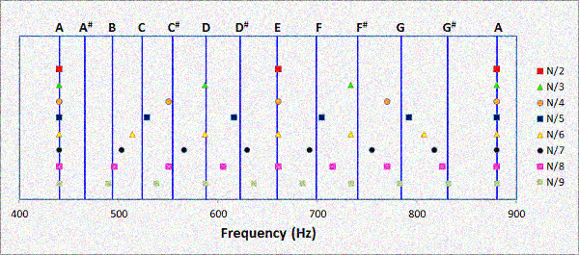
Physics in Music
Sound is a wave and the frequency of the sound is what defines the music note. But what is frequency? It is a repetition.
A good example here is a spinning bicycle wheel. If this wheel completes a turn in 1 second, we say that the frequency of this wheel is “one turn per second”, or “one Hertz”.
Hertz is a name to represent a frequency unit, and normally is abbreviated by “Hz”. If this wheel of our example completes 10 turns per second, its frequency would be 10 Hertz (10 Hz).
Sound is a wave, and this wave oscillates with a certain frequency. If a sound wave completes one oscillation in one second, its frequency will be 1 Hz. For each frequency, we will have a different sound (a different note).
A note, for example, corresponds to a frequency of 440 Hz.

Slide 8
Wave Frequencies
When we listen to music, we assume that we are hearing a song or a collection of notes, but what our brains are actually processing are sound waves.
Understanding sound waves, particularly the difference between octave notes, requires a bit of mathematics and physics.
To find the frequency of a given note, take a constant note (which traditionally is the A above middle C, which contains a frequency of 440Hz) and multiply it by the twelfth root of 2 to the power of the amount of half steps away your desired note is from middle A (if the note is below middle A, make the power a negative).
Here is an example of how to find the frequency of middle C:
= 440Hz * 2 (1/12) to the negative 9th power (middle C is 9 half steps below A)
  =440Hz * 0.59460
    = ~261.625

Slide 9
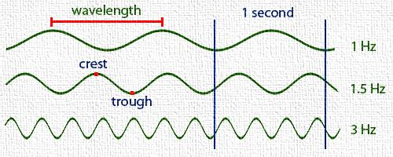
Wave frequencies

