Slide 1
MATHEMATICAL MODELLING OF CELLULAR BEHAVIOUR

Slide 2
CELLULAR BEHAVIOUR
“Cell and tissue, shell and bone, leaf and flower, are so many portions of matter, and it is in obedience to the laws of physics that their particles have been moved, moulded and conformed. They are no exceptions to the rule that God always geometrizes. Their problems of form are in the first instance mathematical problems, their problems of growth are essentially physical problems, and the morphologist is, ipso facto, a student of physical science“
D’Arcy W. Thompson, “On Growth and Form”, 1917

Slide 3
Why are cells so small? Cells are so small that you need a microscope to examine them. And why is that? To answer this question we have to understand that, in order to survive, cells must constantly interact with their surrounding environment.
CELLULAR BEHAVIOUR

Slide 4
CELLULAR BEHAVIOUR
Background information:
Gases and food molecules dissolved in water must be absorbed and waste products must be eliminated. For most cells, this passage of all materials in and out of the cell must occur through the plasma membrane
Each internal region of the cell has to be served by part of the cell surface. As a cell grows bigger, its internal volume enlarges and the cell membrane expands. Unfortunately, the volume increases more rapidly than does the surface area, and so the relative amount of surface area available to pass materials to a unit volume of the cell steadily decreases.

Slide 5
CELLULAR BEHAVIOUR
Small cells:
When a cell is small it has a large surface area in comparison to its volume. Diffusion is thus an effective way to transport substances (e.g. gases and food) into the cell. As it becomes larger, its surface area relative to its volume decreases.
Large cells:
Diffusion is no longer an effective way to transport materials to the internal surrounding of a cell. Hence, there is a physical limit for the size of a cell, with the efectiveness of difusion being the limiting factor.

Slide 6
CELLULAR BEHAVIOUR

Slide 7
CELLULAR BEHAVIOUR
This means that:
As each cube represents a cell, the more cubes there are the more cells the organism has. This represents the change in surface area to volume ratio as you move from unicellular to multicellular organisms.

Slide 8
CELLULAR BEHAVIOUR
Multicellular organisms
As the volume increases, the surface area does not increase at the same rate.
When the surface area to volume ratio is large, there is a lot of surface area for diffusion and not much volume to travel within. This is the case for unicellular organisms, which can rely on diffusion alone to get the substances they need.
When the surface area to volume ratio is small, then there is not much surface area for substances to diffuse across but there are lots of cells inside that need the substances (a high volume). The multicellular organism can't rely just on diffusion to get the substances that all of its cells need.

Slide 9
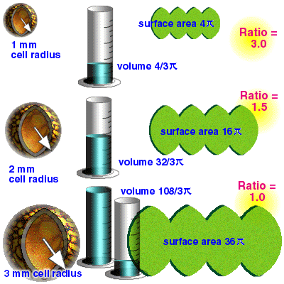
CELLULAR BEHAVIOUR
Take this other example:
In the end, at some point, there is just enough surface available to service all the interior.
If it is to survive, the cell must stop growing.

Slide 10
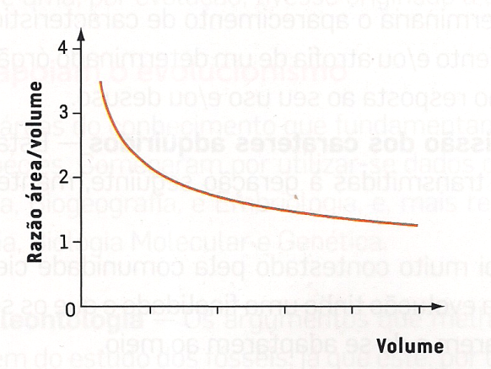
CELLULAR BEHAVIOUR
The important point is that the surface area to the volume ratio gets smaller as the cell gets larger.
Thus, if the cell grows beyond a certain limit, not enough material will be able to cross the membrane fast enough to accommodate the increased cellular volume. When this happens, the cell must divide into smaller cells with favorable surface area/volume ratios, or cease to function.
That is why cells are so small

Slide 11
CELLULAR BEHAVIOUR
Exercises:
1. The diagram below shows four cells of different sizes. They range from a small 2cm cube to a larger 5cm cube. This exercise will help you understand the effect of cell size on the efficiency of difussion.
1.1 Calculate the volume, surface area and the ratioof surface area to volume for each of the four cubes above. The first one has been done for you.

Slide 12
CELLULAR BEHAVIOUR

